Slide 1
Cloning

Slide 2
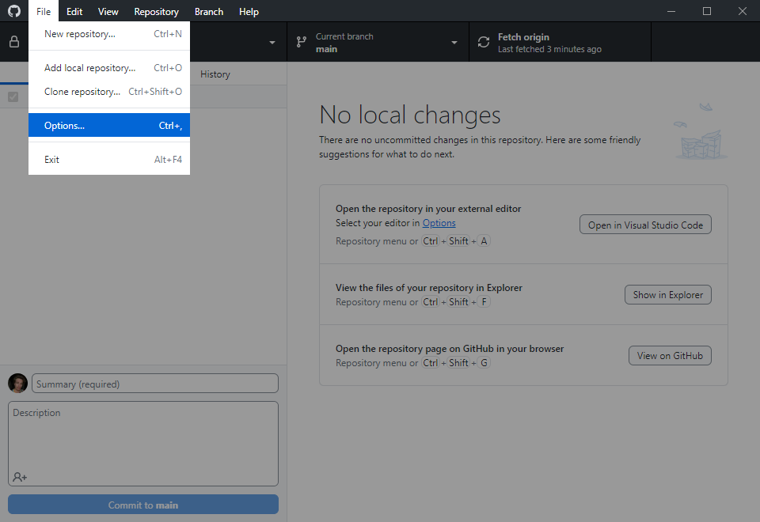
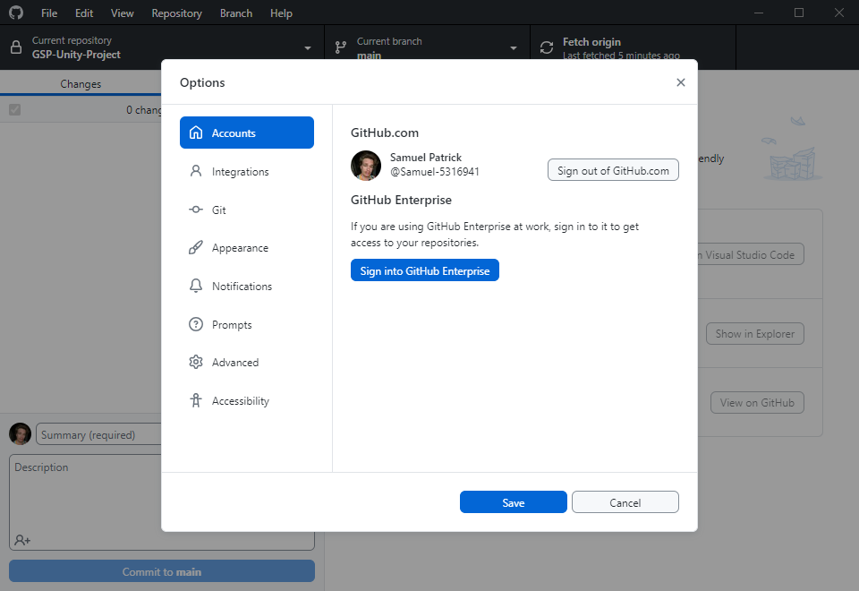
SIGN IN
Go to File > Options
Ensure you are signed in
Review software specification versions on Discord (for all software)

Slide 3
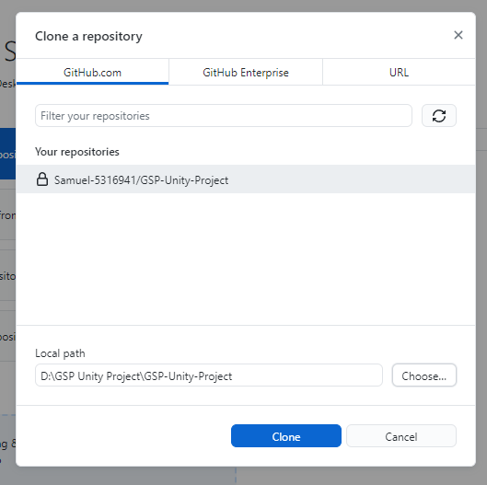
CLONE THE REPOSITORY
This section is duplicated from the on-boarding; skip if you’ve already done it.
Go to File > Clone Repository … and then you should see our repo, “GSP-Unity-Project”. Select that one.
You should clone the repository somewhere out of the scope of any other version control or cloud storage (OneDrive, Google Drive, Dropbox etc). If possible, use the C: drive or D: drive or similar. Directly on the drive you can create a folder called “Git Repositories”.
You should have something like this (and if so, you can Clone)

Slide 4
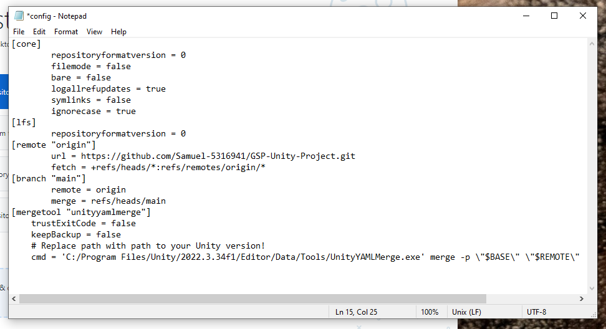
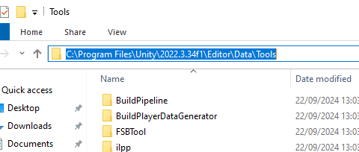
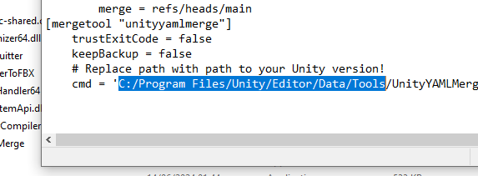
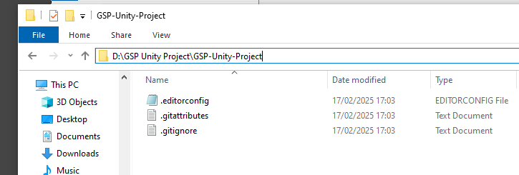
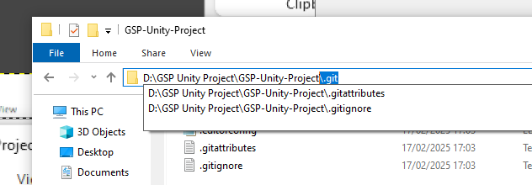
CONFIGURE UNITY YAML MERGE
This must be done every time you clone the GSP-Unity-Project repository (for instance, if you clone in the Labs, you should configure it even if you did it on your local machine).
Navigate to the repo you just cloned. Go to the folder file path, and type the highlighted below onto the end:
This should open up a hidden folder. Open the file “config” in a text editor (right click, Open with…, scroll to Notepad).
Copy this text and paste it in the “config” file. You should have something like this:
Navigate to your Unity installation. You’re looking for the UnityYAMLMerge.exe. It should be somewhere around here, in the Tools folder:
Copy the file path (you’ll have to Ctrl+C). Go to the “config” file in the text editor. Highlight the below path exactly and paste over it exactly with your own path.
[mergetool "unityyamlmerge"]
trustExitCode = false
keepBackup = false
# Replace path with path to your Unity version!
cmd = 'C:/Program Files/Unity/Editor/Data/Tools/UnityYAMLMerge.exe' merge -p \"$BASE\" \"$REMOTE\" \"$LOCAL\" \"$MERGED\"

Slide 5
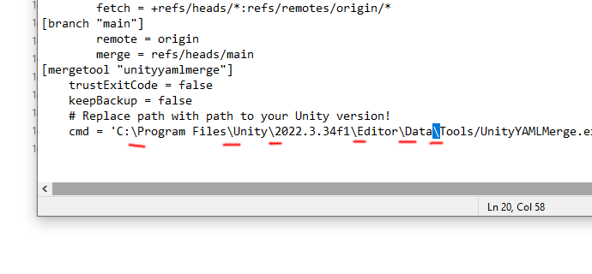
CONFIGURE UNITY YAML MERGE (cont)
You must replace the back-slashes in the text you pasted (from “C:” to “Tools”) with forward-slashes again. Ignore the back-slashes later in this line after the “-p”, they are supposed to be this way. Save the file.
[mergetool "unityyamlmerge"]
trustExitCode = false
keepBackup = false
# Replace path with path to your Unity version!
cmd = 'C:/Program Files/Unity/Editor/Data/Tools/UnityYAMLMerge.exe' merge -p \"$BASE\" \"$REMOTE\" \"$LOCAL\" \"$MERGED\"

Slide 6
REMOVING THE REPO(S) (LABS ONLY)
When you are finished working in the Labs, make sure your changes are committed and pushed.
If you unsure you are pushed, you can check on the GitHub website and look at the repo if you are unsure before you delete the repo from the Lab PC.
Go to Repository > Remove… in GitHub Desktop, then select our repo(s), and remove them, and please tick the box that says “Send to Recycle Bin”).
Any unpushed changes, even committed ones, will be gone forever when you delete a local repository.

Slide 7
Pushing/Pulling

Slide 8
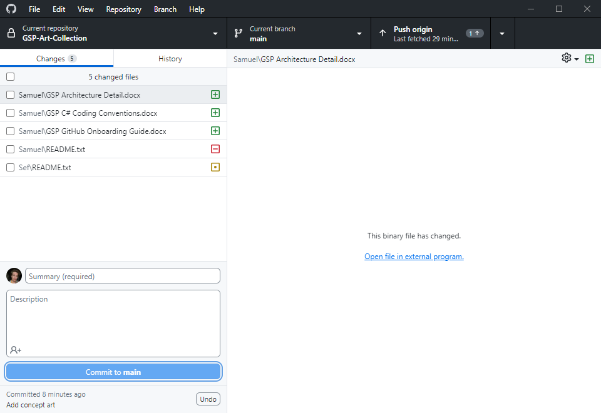
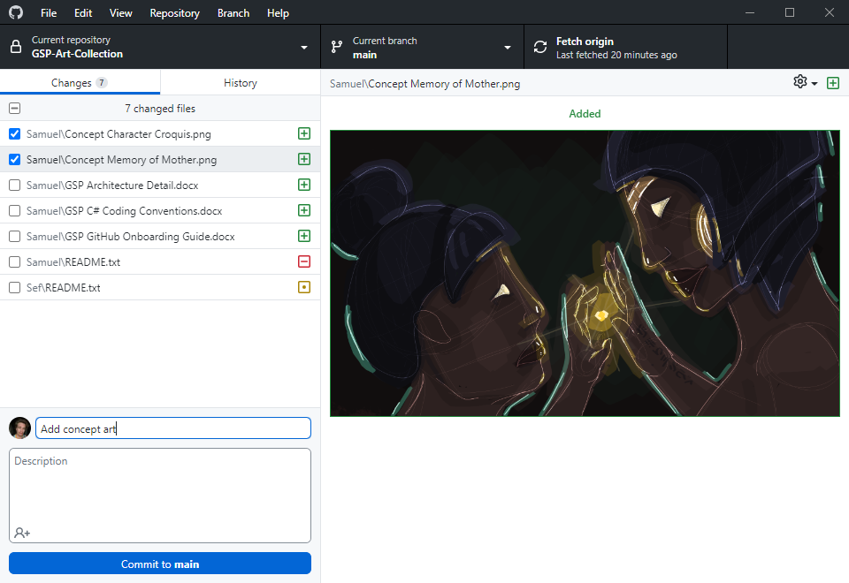
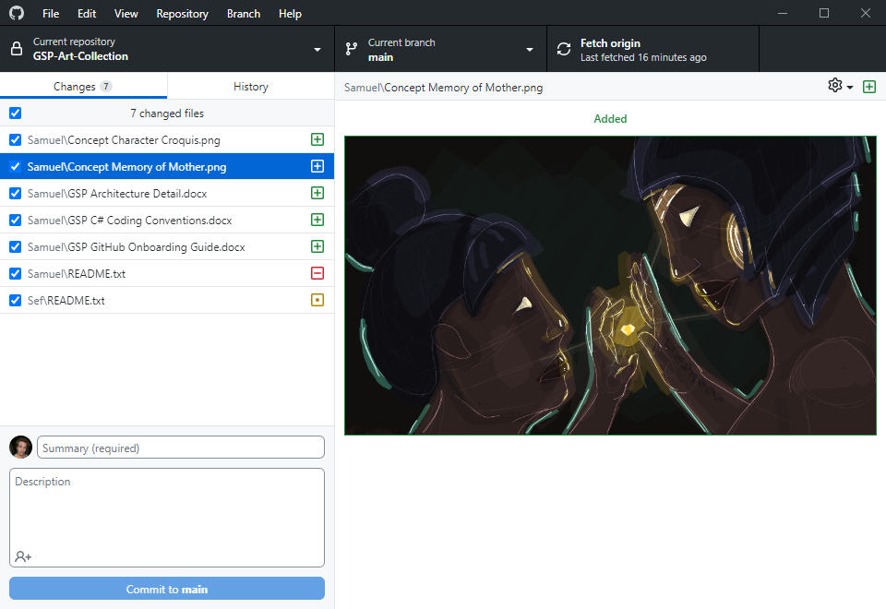
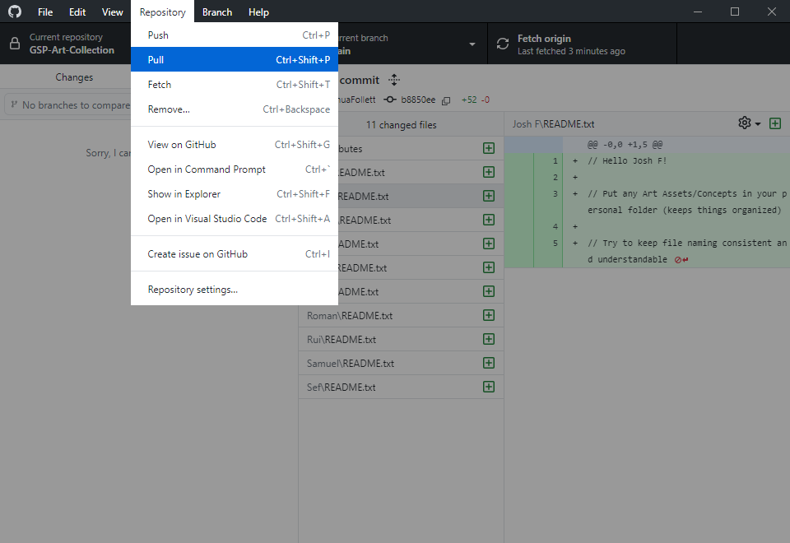
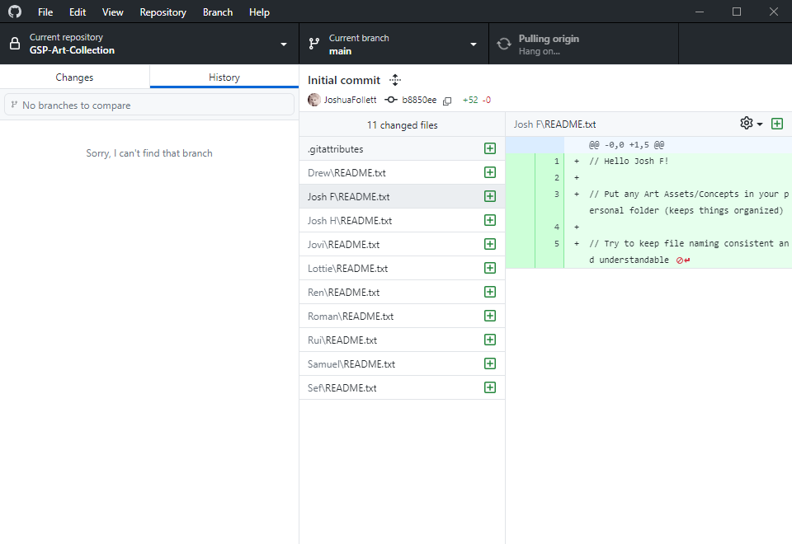
SESSION WORKFLOW
Before making any changes, make sure the correct repository is selected, and the correct branch, and then pull from the repository. This will fetch changes from the remote branch and fast-forward merge your local branch to the latest commit.
This is a network process and can take a while if there are many commits. See “Pulling origin, hang on…”
When you have made changes and you are ready to commit, you can go to the changes tab to see the staging area.
You can see that my local branch has now diverged from the latest commit (in this case, the remote branch’s latest commit). GitHub Desktop will highlight the nature of the changes: new, deleted, or edited.
Any changes you uncheck will be unstaged. Select only the files you want to commit. I have selected only the art files. It is crucial to commit sensibly; see slides 13, 18 and 19 for more guidance. Description and co-authors is not mandatory.
Now that I have committed, those changes are cleared from the staging area.

Slide 9
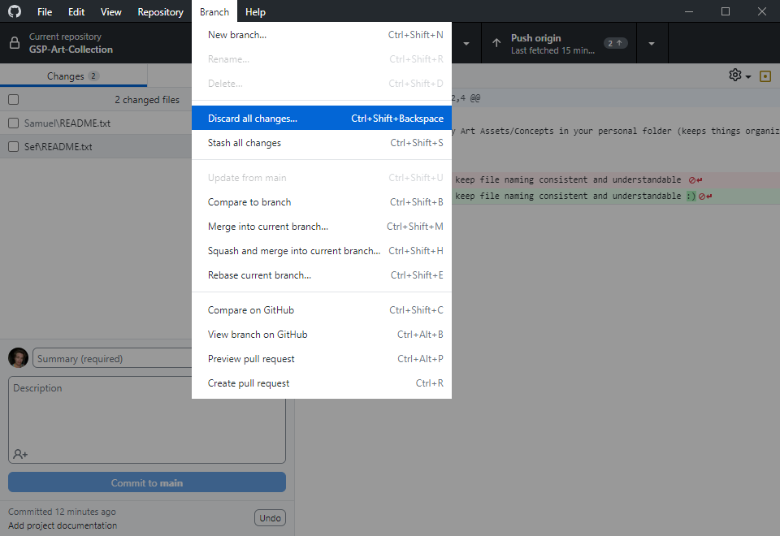
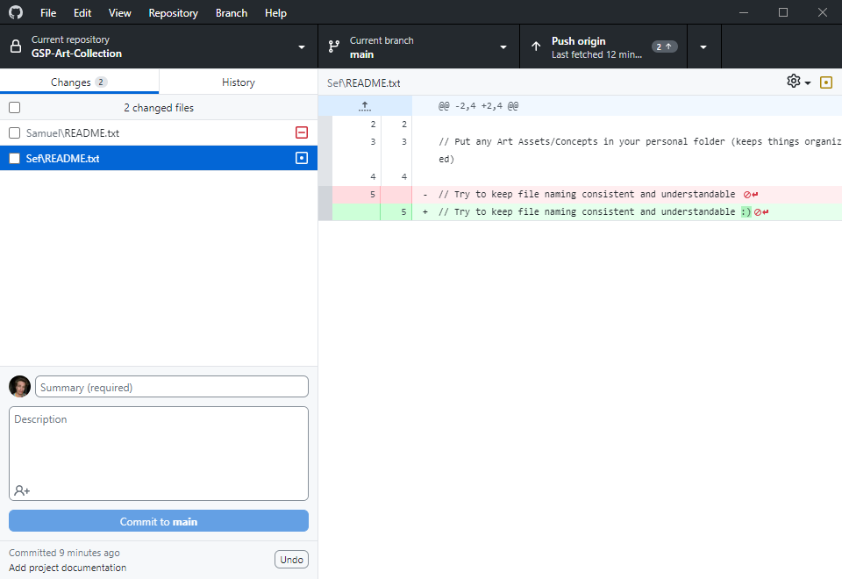
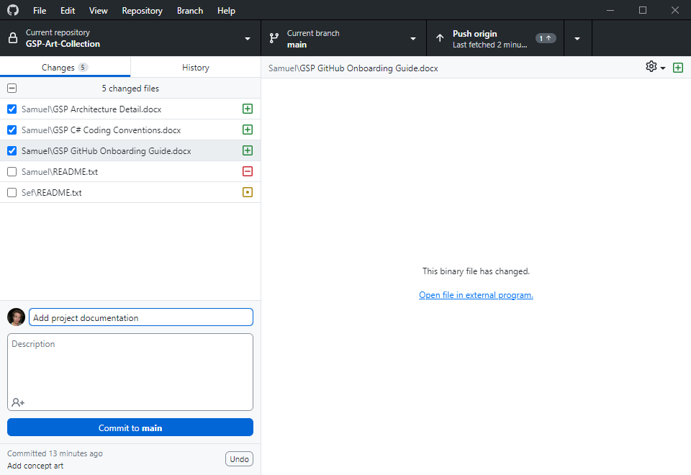
SESSION WORKFLOW (cont)
I will make another commit. In the staging area, the changes are compared to the latest commit which is now my unpushed “Add concept art” commit. See slides 15-17 if this doesn’t make sense.
Since these commits are not yet pushed, they are not yet available to others remotely.
Now I’ve committed everything I want to, I’m left with two files I didn’t mean to change.
I can discard these changes. This will discard any changes since the last commit, whether pushed or unpushed.
Let’s analyse this:
In the “Add project documentation” commit, these two files will be referenced “unchanged since last commit”.
So Git looks back to to the previous “Add concept art” commit and sees again “unchanged since last commit”.
Then tracks back again (Josh’s initial commit which I pulled) and sees for both files “file was created”. It is comparing my changes to this information. It will restore those files as they were then.

Slide 10
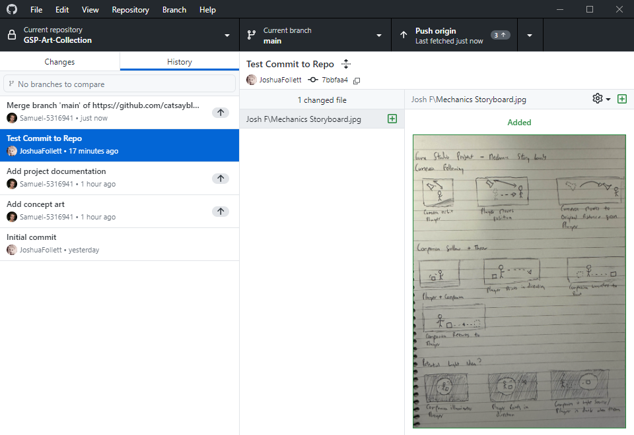
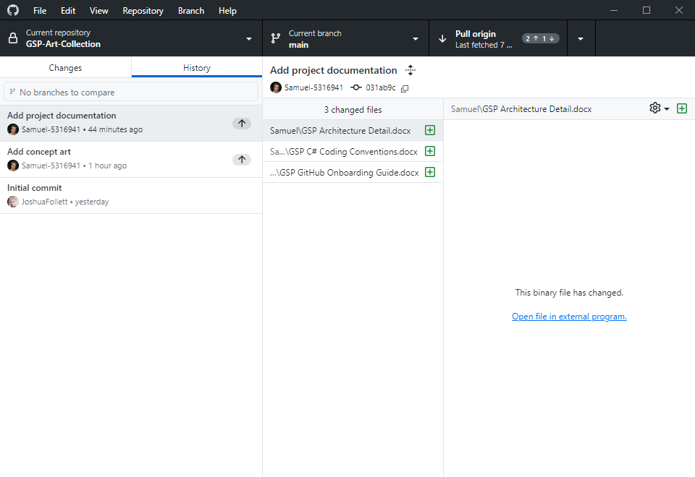
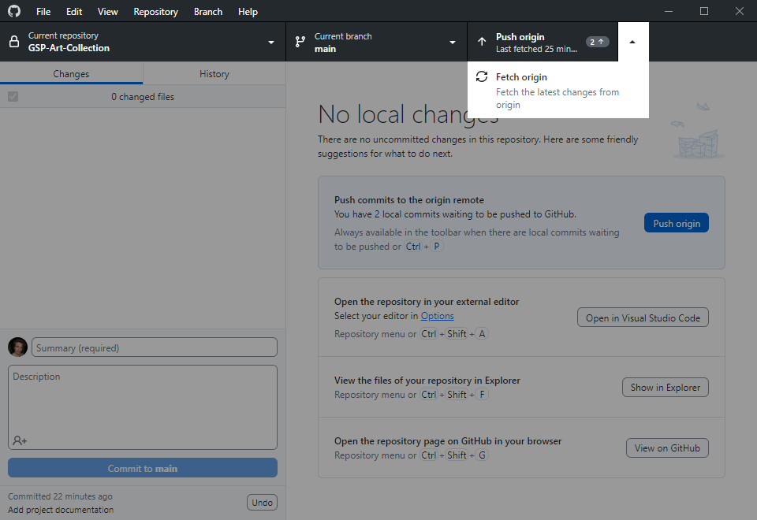
SESSION WORKFLOW (cont)
Now that you have no local (uncommitted) changes, and we are finished editing, we can push. Notice the little 2 next to push origin. That’s because there are two unpushed commits. If you look at the history tab, your unpushed commits will have a little arrow next to them to signal that they aren’t yet pushed.
Before push, we should fetch origin. There is a chance someone pushed changes since I last pulled.
Now I’ve fetched, notice how push origin has now changed to pull origin and a little 1 has also appeared. That’s because someone did indeed make a commit and I am behind.
There are ways to see the fetched changes and compare them to your commits. Regrettably, GitHub Desktop doesn’t provide that functionality. So in this scenario, you must blindly pull (which will merge them into your local branch) to get back on track.
Josh’s commit has been pulled into my local branch. This created a merge commit which merged Josh’s pushed commit and my unpushed commits together. Luckily, we didn’t touch the same files. If we did, we’d have to manage a merge conflict.

Slide 11
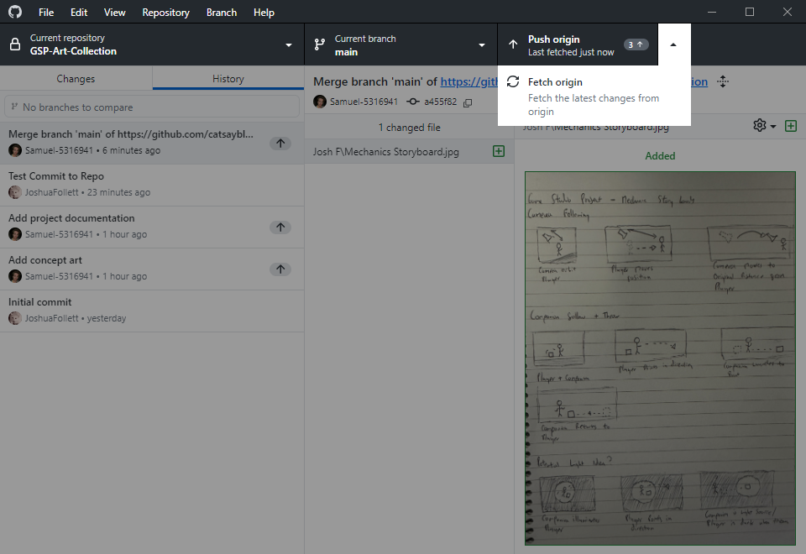
SESSION WORKFLOW (cont)
Now that the merge commit is dealt with, you should fetch again. We didn’t spend long on this merge commit but if there was a really big change by someone else we might have had a lot of conflicts to solve.
This is why if you are facing a conflict, it’s a good idea to call for backup, and ask people to stop piling on and pushing more commits while you work through it.
So I’ve fetched and there’re no changes to the repo since I last pulled. I can now push my changes. Notice it now says 3: I didn’t make a new commit, but Git automatically created a merge commit when I pulled. This only happens if Git cannot fast-forward (i.e., someone has pushed since you last made a commit).
My local branch is now harmonious with the remote branch.
Any changes you do not commit will never be pushed. Others will not be able to pull them from the remote branch.

Slide 12
SESSION WORKFLOW (Cheatsheet)
When to fetch or pull?
Whenever you get to work and open GitHub desktop, use these scenarios.
You can see it is simpler and easier to regularly push your changes, but it is inadvisable to push stuff that is largely incomplete or broken (your commits may be pulled by people who rely on them!)
Push when you can, and let people know if you’ll be working on something for a few days before you can push the changes.
I have no unpushed commits and no local changes
You can safely pull and your directory will be fast-forwarded to the latest commit
I have unpushed commits and no local changes
You should fetch, pull, merge conflicts if required, continue working and committing or push if you are ready (preferably push if your feature is relatively complete)
I have local changes
You should first finish your edits and commit them, or discard them if they were not deliberate, fetch, pull, merge conflicts if required, then continue working and committing or push if you are ready (preferably push if your feature is relatively complete)

Slide 13
Merge Conflicts

Slide 14
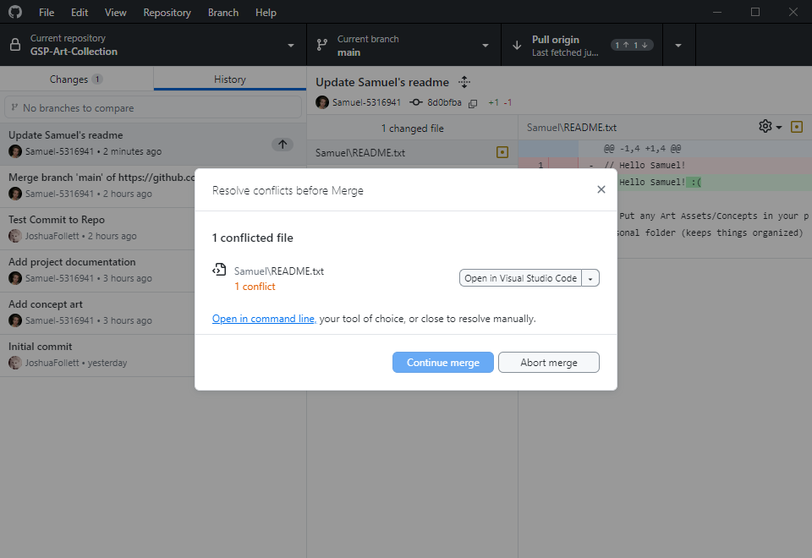
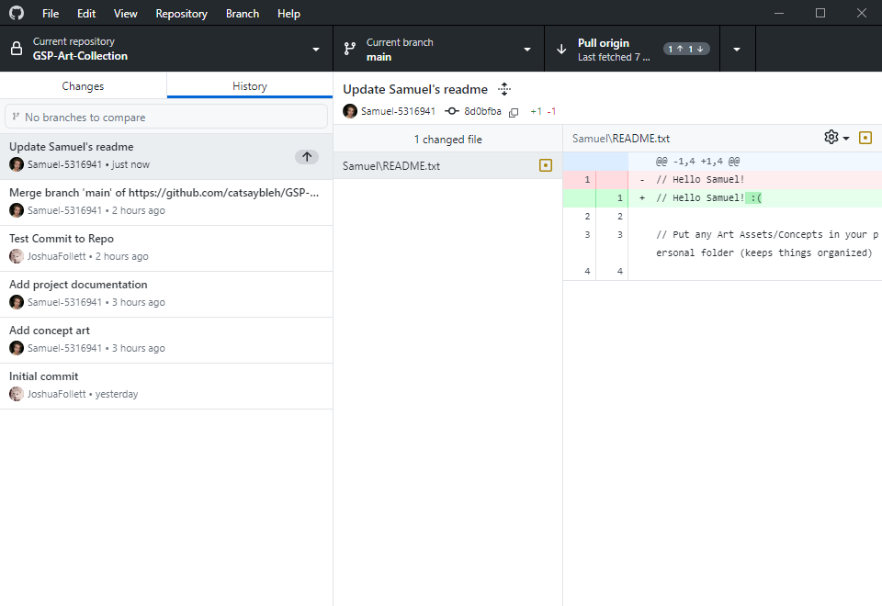
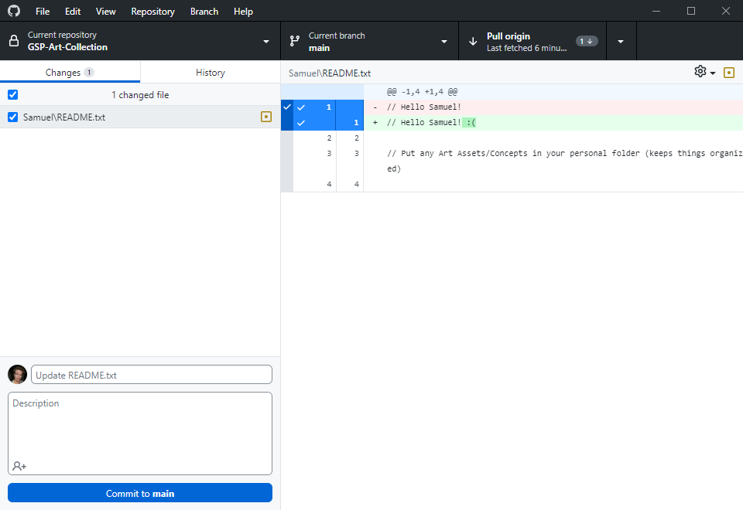
MERGE CONFLICTS
You can see I have edited a text file.
Now I will commit this change.
Now I have fetched before pushing. You can see I have one commit to push (my text file) and I am also one commit behind (Josh has made a commit). We need to pull the changes Josh made into my commit and create a merge commit before I can push.
We have run into a merge conflict. In my commit, there are files which were also edited in Josh’s commit.
If the merge conflict is too complex, you can abort it and call for backup.
Only when you have resolved all conflicts will it be possible to continue merge.
With text files, Git will manage a lot of the merge scenarios intelligently.
However, with art assets, this is reduced to a simple choice. Unity assets normally are incompatible for an intelligent or graceful merge. You will need to choose one or the other and we will treat this text file the same way.

Slide 15
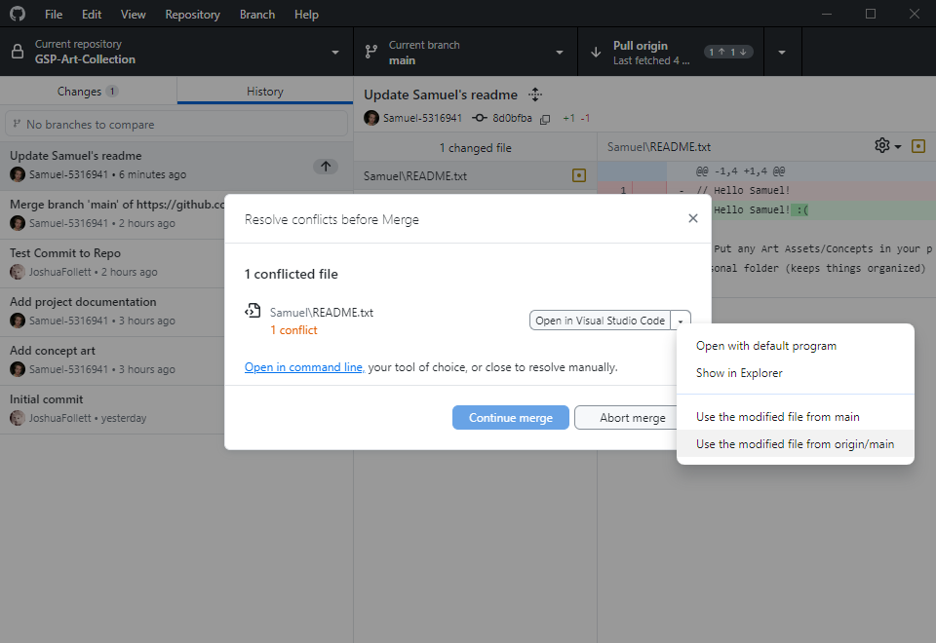
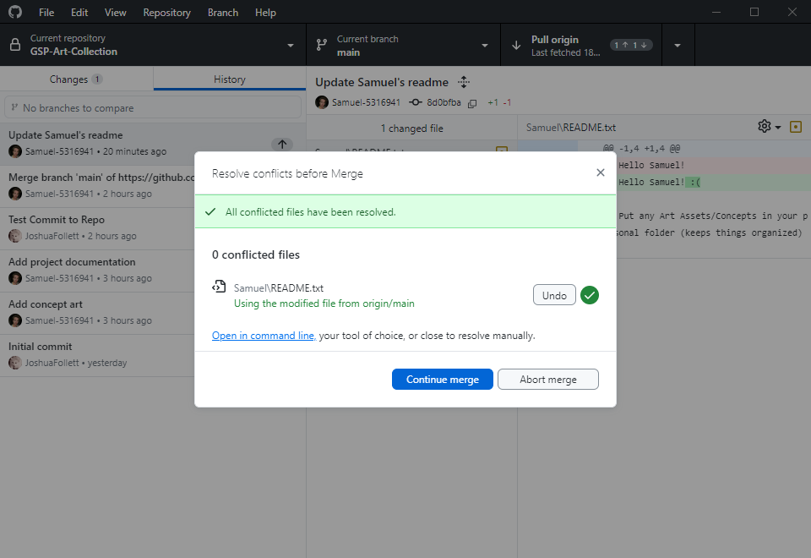
MERGE CONFLICTS (cont)
If you expand the dropdown, you can see two options:
Use modified file from main
Use modified file from origin/main
Here, main refers to the name of the branch you are on. Yours may not be called main (this is normally a protected branch).
The main consideration here is that the file from origin is the one you’ve pulled in, and the other is the file you edited that’s conflicting. You can choose one or the other. I will choose the one from origin to overwrite by file.
If I am so inclined, I might copy out my file to another directory to preserve it for now, before I choose Josh’s file, and add the changes back in later. This is completely acceptable, although Git methodology says that you should stash your changes and merge over them. You can also abort and try a rebase. I won’t cover those options but I mention them in the case you want to learn more elsewhere.

Slide 16
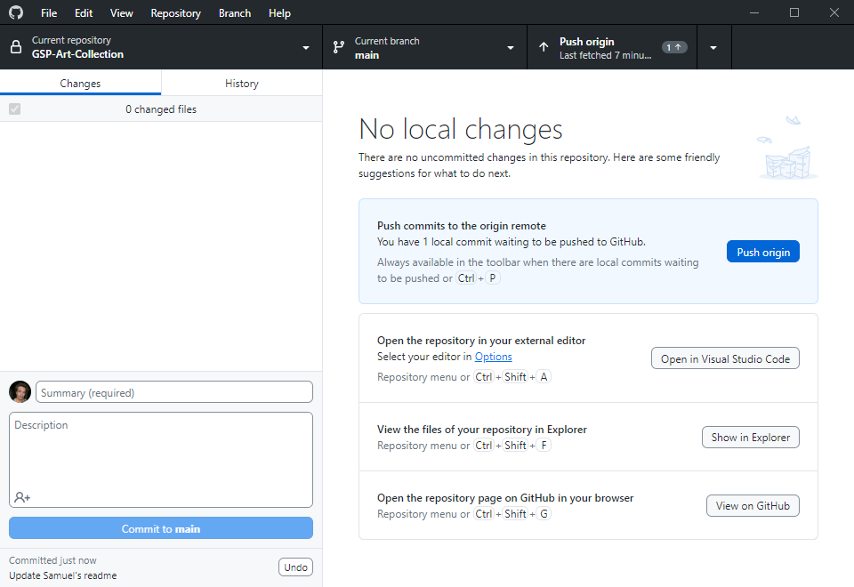
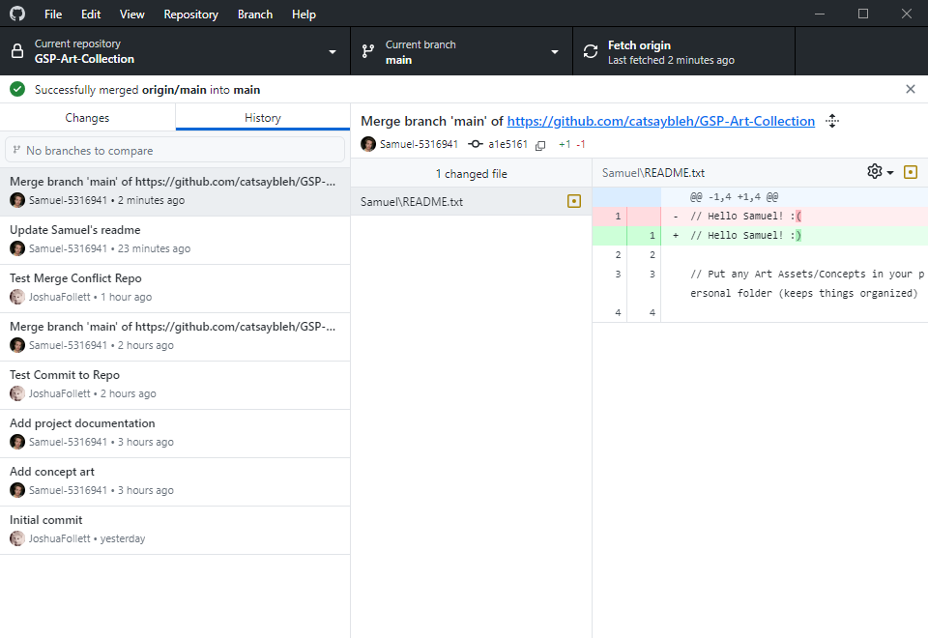
MERGE CONFLICTS (cont)
Now, you can see in the history that a merge commit has been created. The merge was successful but this still only locally available. I need to push my merge commit to fully resolve the conflict.
I must fetch again, and if there are no commits to pull, I will push my changes.
If you make a mistake, you can undo the latest unpushed commit right underneath the commit button. There are two types of “undo”: revert and reset. Git often will intelligently choose for you, but if it asks you for help deciding:
Revert is preservative: it changes the commit you made (and directory) to match the specified previous commit.
Reset is destructive in that it erases the commit, and depending on the type of reset, it can revert your files too.
If you made a mistake and want to undo the commit and the revert files, reset hard.
If you committed the wrong files but want to keep the edits you made, reset soft. This will undo the commit but leave the files alone and automatically stage them.
You should only try to undo pushed commits if you know the implications.

Slide 17
Branches

Slide 18
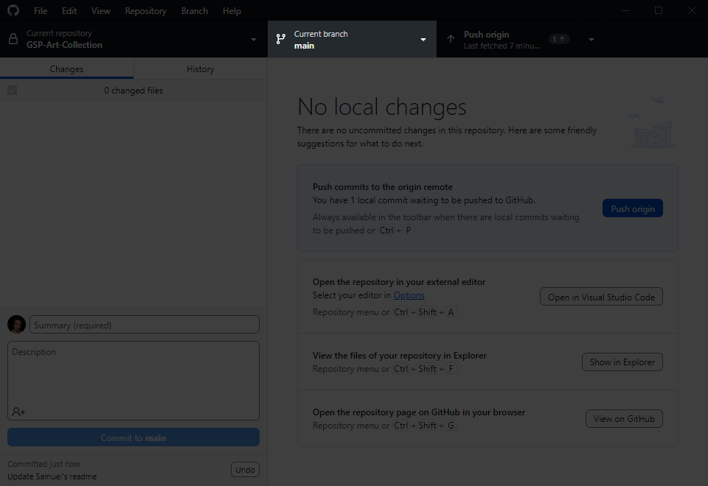
CHECKOUT BRANCH
Alice and Bob want to see their camera in action. The good news is, they’re not tied to main/camera. Instead of complicating things by rebasing, they can simply use their GitHub client to checkout the main/level branch. Their working directory will switch to Carol and Dave’s (and theirs will be preserved on the remote repository).
You can change the branch you are on very simply.
This is a powerful feature and your entire folder will change to the latest commit on the branch you switch to. You should only do this if you have no local changes. If you have unpushed commits, Git will preserve them in your local repository until you return to that branch, but switching branches will not push your local changes/commits for you.

Slide 19
This is a proposal of our branch strategy, and where everyone’s “home branch”, where you will push your work, might be.
As mentioned, you are not glued to one branch. It is easy to change between them to see what is going on elsewhere, to see your features in action on prod, and to help with QA testing, or to come to the rescue of someone in need of help with their asset.
Probably Drew will have to spend their time split between characters and assets! I have also not put boss anywhere; I thought probably he will want/need to switch between most branches.
Let’s discuss this to make sure everyone is happy with it.
main
Main branch should always compile a stable, tested game version: alpha -> beta -> gold
qa
No chores or features should be done on QA branch: everything’s pulled in when testing needs to start
prod
Production branch: assets/features are pulled together, level built/implemented, compile this branch for “live version”
Ren
Rui
feature
Feature branch for programming and implementing features concurrently (there’s often several child branches)
Josh F
Samuel
chars
Character branch that branches from feature; programming features are required to make characters function
Lottie
Roman
Drew
asset
Assets can be built and perfected in isolation from the the other development and each pulled when ready
Jovi
Sef

Slide 20

Cycle repeats for beta and for submission; except when qa begins for submission, development winds down
Reach alpha; production still continuing
Current development is pulled into qa, to begin testing a rough alpha: “wherever we’re at”
Project begins; blank Unity project is ready
Production is underway on all development branches
Finished features and assets are pulled into prod branch, level building continues (many times)
Alpha version is tested; production continues; work toward beta
Project initiation
QA for Alpha
QA for Beta
QA for Sub
Alpha
Beta
Sub
main
qa
prod
feature
chars
asset
This is not a timeline or a perfectly accurate blueprint. It’s a representation to help everyone understand how to work.

Slide 21
ASSET FOLDER STRUCTURE
All of the heavy cache files are configured to be ignored by the repo. That means when you change and push, only your work is pushed, not your cache files.
Unity assets cannot have spaces in their filepath/filename.
Please do not commit changes to the repo from the wrong branch. If you are working on the assets branch, please do not edit the scenes, and if you are working on the production branch, please do not edit the models, etc.
Any changes you make in this way could be overwritten or undone! And probably unintentionally! If there is a bug or a glitch and it’s not your area, tell the responsible person, so that they can fix it. Please don’t try and edit it, you will create a merge conflict.
There is a WIP folder for anything you want to copy out and test a change that’s out of the scope of your branch. Our repository is configured to ignore any files in the WIP folder. Experiment away.
And finally, please do not store anything that is not a Unity asset. We have to be conservative with storage. Use the art repo or your WIP folder.
Resources
Rendering
Shaders
Settings
Audio
Music
Ambient
Samples
Scripts
Library
Editor
Architecture
GameObjects
ScriptableObjects
Strings
Prefabs
UI
Components
Managers
Controllers
GameObjects
Scenery
Props
Characters
Effects
Animators
Models
Scenery
Meshes
Materials
Textures
Props
Meshes
Materials
Textures
Characters
Meshes
Materials
Textures
Scenes
WIP

Slide 22
Tracking

Slide 23
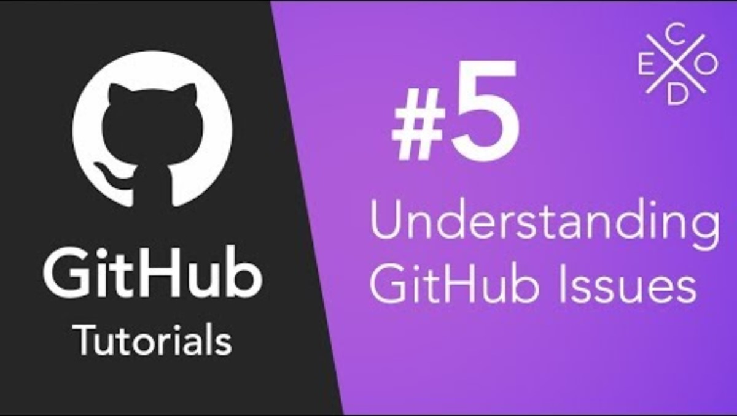
CHECKOUT BRANCH
Please watch this (relatively helpful) video to understand the tracking of bugs and issues on the GitHub website.
When you assign issues please do not assign them to individuals; someone might get landed with more than their fair share of work. Please assign them to teams like “programmers”, “prop artists” etc.
When you are working on fixing a logged issue, please use the methods in this video to link your commits that fix things with the issue they are fixing.

